Slide 1
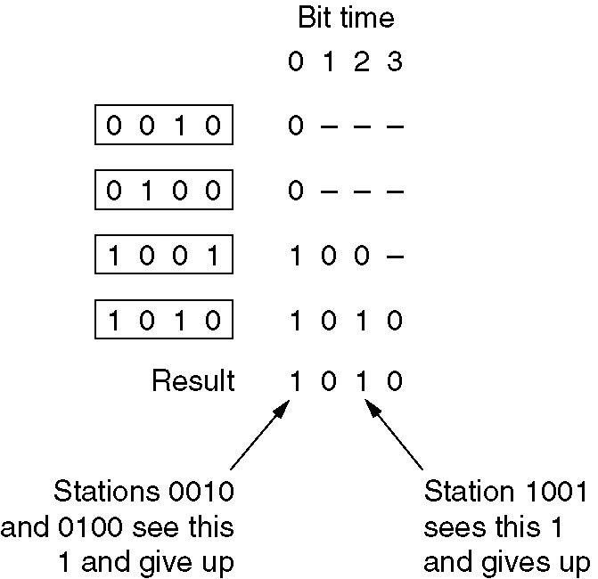
Binary Countdown Example
Suppose that channels 0010, 0100, 1001, 1010 are all trying to access the channel
The binary countdown protocol.
A dash indicates silence.

Slide 2
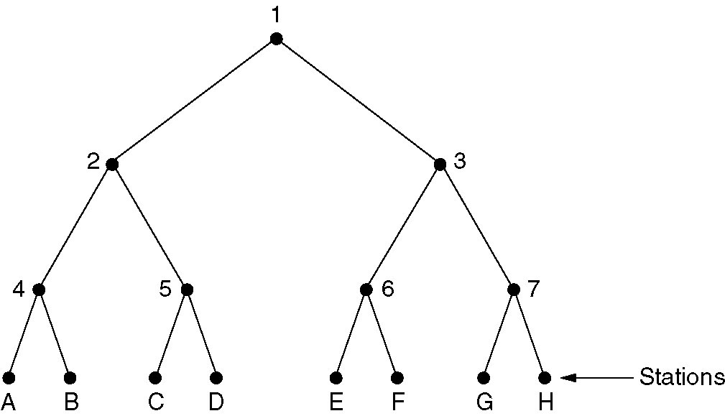
Adaptive Tree Walk Protocol
The tree for eight stations

Slide 3
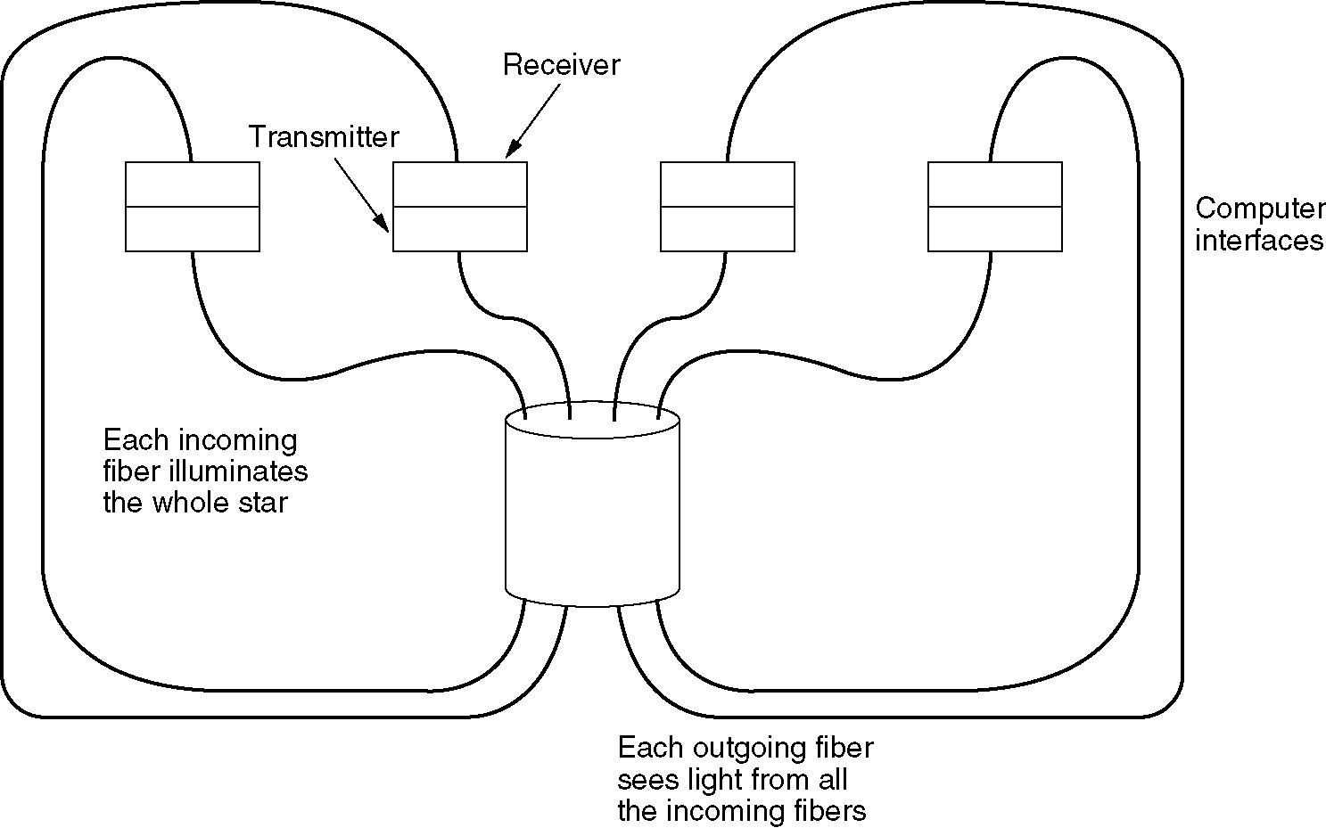
Optical LAN Example
A passive star connection in a fiber optics network.
Silica
Cylinder

Slide 4
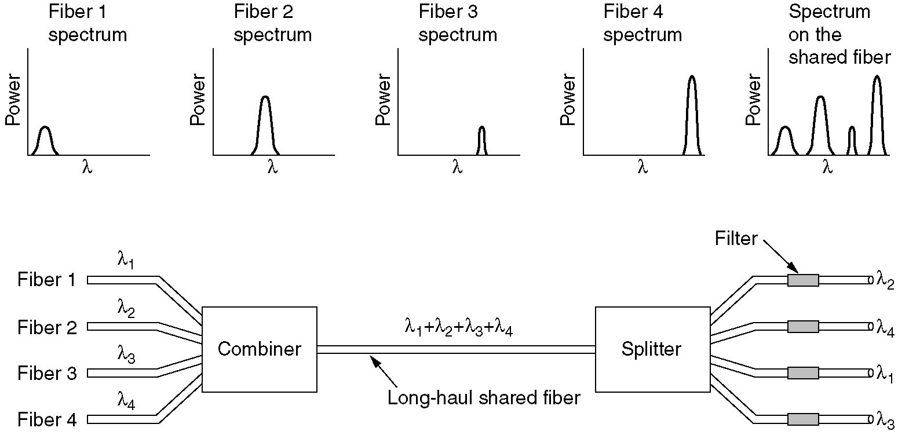
Wavelength Division Multiple Access Protocols
Each station is assigned two channels using Wavelength Division Multiple Access (WDMA)
  Narrow channel is provided as a control for station signaling
  Wide channel is provided for station output data frames

Slide 5
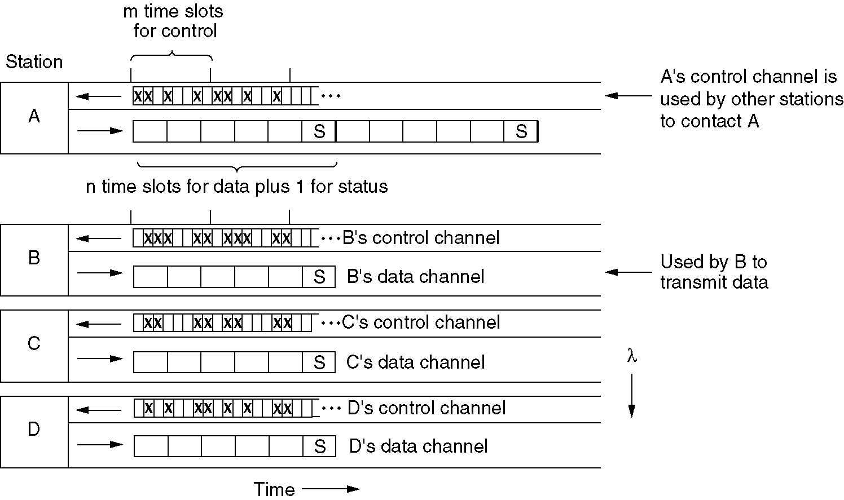
Wavelength Division Multiple Access Protocols

Slide 6
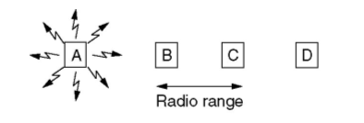
Hidden Station Problem

Slide 7
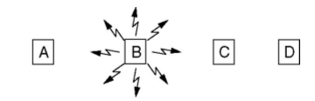
Exposed Station Problem

